Slide 1
CUSTOMER SUPPORT ANALYSIS Presented By: Emeh GlorY Chiamaka Mentor: Mr. Joshua Ogbudu Group: Advanced Data Analysis 112

Slide 2
agenda
Overview
Insights
Conclusion
Recommendation

Slide 3
What the Data is Telling Us
Overview
Over the period analysed, the support team handled 5,000 customer cases, demonstrating strong operational capacity.
However, only 54.8% of these cases were fully resolved, indicating that nearly half of customer issues remain unresolved.
While 60.58% of cases are resolved at first contact, suggesting good initial response effectiveness, a 19.8% escalation rate highlights that a notable portion of issues still require additional intervention.
With an average handling time of 25.75 minutes, the team shows reasonable efficiency, but this is not yet translating into consistently successful outcomes.
This indicates over all, support performance is moderate — the team is active and relatively efficient, but there is a clear opportunity to improve resolution rates and reduce escalations, particularly by strengthening first contact resolution.

Slide 4
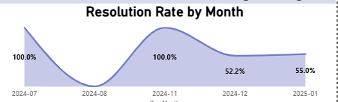
Resolution Rate Trend: A Story of Instability
The monthly resolution trend shows a strong start, with 100% resolution achieved in July, indicating optimal performance at the beginning of the period.
However, this was followed by a complete breakdown in August, where resolution dropped to 0%, suggesting a significant operational disruption — cases were handled by newbies, but not successfully resolved.
Encouragingly, performance recovered fully by November, returning to 100% resolution, which demonstrates the team’s ability to bounce back after setbacks.
Despite this recovery, the most recent data shows resolution at approximately 55% in January, indicating that performance has not yet stabilized.

Slide 5
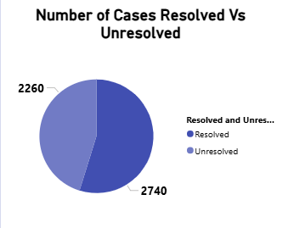
Resolution Outcome — Are We Truly Solving Problems?
Out of the 5,000 customer cases handled, a total of 2,740 cases were successfully resolved, while 2,260 cases remained unresolved.
This means that nearly half of all customer issues are not being fully addressed, despite the effort put into handling them.
This reveals a critical gap between effort and outcome — a significant portion of customers are leaving without a solution, which can negatively impact satisfaction, trust, and overall customer experience.

Slide 6
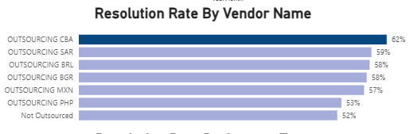
Vendor Performance — Uneven Service Quality
Analysing resolution rates across vendors reveals noticeable differences in performance.
The top-performing vendor, Outsourcing CBA, achieves approximately 62% resolution, followed by Outsourcing SAR at 58.8%, while Non-outsourced support records the lowest performance at around 52%.
This variation indicates that while some vendors are delivering relatively better outcomes, others are lagging behind.
This suggests a lack of standardization in how customer issues are handled and resolved To improve overall support effectiveness, there is a need to review underperforming vendors, share best practices from top performers, and implement targeted training to ensure more consistent service delivery.

Slide 7
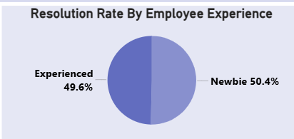
Resolution by Support Type — Performance Gaps Across Channels
When comparing resolution rates by experience level, the difference is almost negligible.
New employees achieve a resolution rate of 50.4%, while experienced staff follow closely at 49.6%. This indicates that both groups are performing at nearly the same level.
The minimal gap suggests that experience is not significantly influencing performance outcomes.
Business Implication:
Training programs are highly effective for new hires, or
The expertise of experienced staff is not being fully utilized

Slide 8
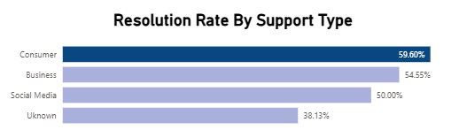
Employee Experience — Minimal Impact on Performance
Resolution performance varies significantly across support channels.
Consumer support leads with approximately 59.6% resolution, followed by Business support at 54.5%, while Social Media support drops to 50%.
Most notably, the “Unknown” category records the lowest performance at just 38%, indicating a substantial gap in effectiveness.
The data highlights clear inefficiencies across certain channels — particularly the “Unknown” category, which significantly underperforms, and Social Media support, which is less effective compared to other channels.
Business Implication:
Poor performance in these channels suggests issues with case classification, process clarity, or handling quality, which can negatively impact overall resolution rates.

Slide 9
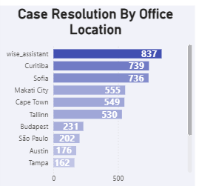
Location Performance — Uneven Workload Distribution
Case volume varies significantly across locations. Top-performing locations include:
Wise Assistant – 837 cases
Curitiba – 739 cases
Sofia – 736 cases
Makati City – 555 cases
These locations handle a disproportionately higher share of total cases.
Workload is not evenly distributed, with certain offices carrying a much heavier operational burden.
Business Implication:
Uneven distribution may lead to:
Agent burnout in high-volume locations
Underutilization of other offices
Some locations are doing significantly more work than others. This imbalance could affect performance, efficiency, and even employee well-being.

Slide 10
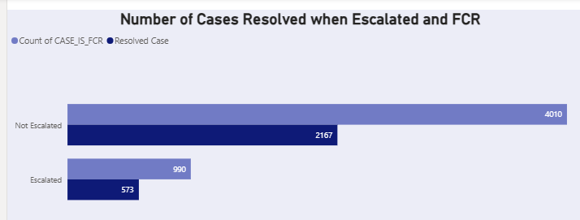
Escalation & FCR — Volume vs Complexity
The majority of cases are handled without escalation, indicating strong frontline support capacity. However, escalated cases, while fewer, tend to be more complex and resource-intensive
While most issues are resolved at the first level, escalations represent high-complexity cases that require deeper expertise.
Business Implication:
There is a need to:
Maintain strong first-level resolution capability
Ensure specialized handling for escalated cases

Slide 11
SO WHAT’S REALLY GOING ON? Key Insights
Resolution rate is too low
August shows process failure
FCR is the biggest efficiency driver
Performance varies across vendors & channels
Time is improving, but outcomes are not

Slide 12
WHAT SHOULD WE DO? Action Plan
Improve First Contact Resolution Better training, scripts, knowledge base
Investigate August issue Identify root cause (staffing/system/process)
Standardize vendor performance Benchmark top performers
Fix data quality (“Unknown”) Improve categorization
Focus on unresolved cases Introduce follow-up tracking.

Slide 13
FINAL MESSAGE - Final Thought
We are getting faster — In summary, the team is becoming more efficient in handling cases, but not more effective / better at solving problems. Improving resolution, especially at first contact, is the biggest opportunity to boost both operational efficiency and customer satisfaction.

Slide 14
Thank you
Emeh Glory Chiamaka
+2348063688426

